Slide 1
Applied Cryptography cryptanalysis of the substitution cipher, Kasiski’s method, index of coincidence
Liangfeng Zhang
School of Information Science and Technology
ShanghaiTech University

Slide 2
Cryptanalysis of the Substitution Cipher
EXAMPLE: Decrypt the following ciphertext in the substitution cipher:
YIFQFMZRWQFYVECFMDZPCVMRZWNMDZVEJBTXCDDUMJ
NDIFEFMDZCDMQZKCEYFCJMYRNCWJCSZREXCHZUNMXZ
NZUCDRJXYYSMRTMEYIFZWDYVZVYFZUMRZCRWNZDZJJ
XZWGCHSMRNMDHNCMFQCHZJMXJZWIEJYUCFWDJNZDIR
letter | A | B | C | D | E | F | G | H | I | J | K | L | M
No. | 0 | 1 | 15 | 13 | 7 | 11 | 1 | 4 | 5 | 11 | 1 | 0 | 16
letter | N | O | P | Q | R | S | T | U | V | W | X | Y | Z
No. | 9 | 0 | 1 | 4 | 10 | 3 | 2 | 5 | 5 | 8 | 6 | 10 | 20
We guess: $d_{K}$(Z)=e; $d_{K}$({M,C,D,F,J,R,Y})$⊆${t,a,o,i,n,s,h,r}

Slide 3
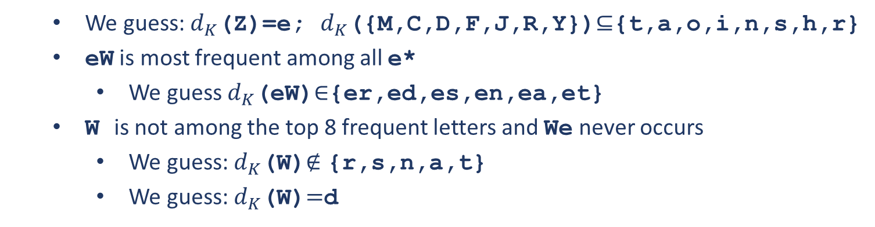
TH, HE, IN, ER, AN, RE, ED, ON, ES, ST, EN, AT, TO, NT, HA, ND, OU, EA, NG, AS, OR, TI, IS, ET, IT, AR, TE, SE, HI, OF.
EXAMPLE: Decrypt the following ciphertext in the substitution cipher:
YIFQFMeRWQFYVECFMDePCVMReWNMDeVEJBTXCDDUMJ
NDIFEFMDeCDMQeKCEYFCJMYRNCWJCSeREXCHeUNMXe
NeUCDRJXYYSMRTMEYIFeWDYVeVYFeUMReCRWNeDeJJ
XeWGCHSMRNMDHNCMFQCHeJMXJeWIEJYUCFWDJNeDIR
diagram | De | eW | Ne | eU | Re | He | Xe | Fe | eR | eV | eC | eD
No. | 4 | 4 | 3 | 3 | 2 | 2 | 2 | 2 | 2 | 2 | 2 | 2
We guess: $d_{K}$(Z)=e; $d_{K}$({M,C,D,F,J,R,Y})$⊆${t,a,o,i,n,s,h,r}
eW is most frequent among all e*
We guess $d_{K}$(eW)$∈${er,ed,es,en,ea,et}
W is not among the top 8 frequent letters and We never occurs
We guess: $d_{K}$(W)$∉$ {r,s,n,a,t}
We guess: $d_{K}$(W)$=$d

Slide 4
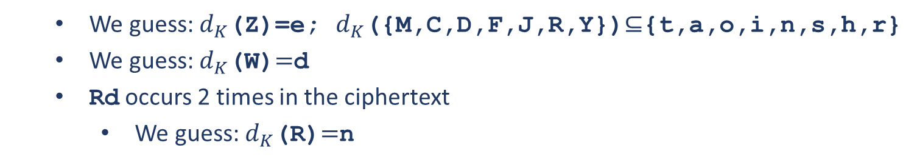
TH, HE, IN, ER, AN, RE, ED, ON, ES, ST, EN, AT, TO, NT, HA, ND, OU, EA, NG, AS, OR, TI, IS, ET, IT, AR, TE, SE, HI, OF.
EXAMPLE: Decrypt the following ciphertext in the substitution cipher:
YIFQFMeRdQFYVECFMDePCVMRedNMDeVEJBTXCDDUMJ
NDIFEFMDeCDMQeKCEYFCJMYRNCdJCSeREXCHeUNMXe
NeUCDRJXYYSMRTMEYIFedDYVeVYFeUMReCRdNeDeJJ
XedGCHSMRNMDHNCMFQCHeJMXJedIEJYUCFdDJNeDIR
diagram | ed | Rd | dD | dN | Cd | Fd | dG | dI | dJ | dQ
No. | 4 | 2 | 2 | 2 | 1 | 1 | 1 | 1 | 1 | 1
We guess: $d_{K}$(Z)=e; $d_{K}$({M,C,D,F,J,R,Y})$⊆${t,a,o,i,n,s,h,r}
We guess: $d_{K}$(W)$=$d
Rd occurs 2 times in the ciphertext
We guess: $d_{K}$(R)$=$n

Slide 5
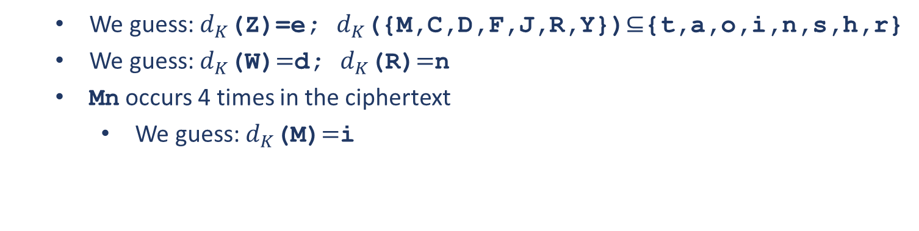
TH, HE, IN, ER, AN, RE, ED, ON, ES, ST, EN, AT, TO, NT, HA, ND, OU, EA, NG, AS, OR, TI, IS, ET, IT, AR, TE, SE, HI, OF.
EXAMPLE: Decrypt the following ciphertext in the substitution cipher:
YIFQFMendQFYVECFMDePCVMnedNMDeVEJBTXCDDUMJ
NDIFEFMDeCDMQeKCEYFCJMYnNCdJCSenEXCHeUNMXe
NeUCDnJXYYSMnTMEYIFedDYVeVYFeUMneCndNeDeJJ
XedGCHSMnNMDHNCMFQCHeJMXJedIEJYUCFdDJNeDIn
diagram | Mn | en | nd | ne | nN | Cn | Dn | In | Yn | nE | nJ | nT
No. | 4 | 2 | 2 | 2 | 2 | 1 | 1 | 1 | 1 | 1 | 1 | 1
We guess: $d_{K}$(Z)=e; $d_{K}$({M,C,D,F,J,R,Y})$⊆${t,a,o,i,n,s,h,r}
We guess: $d_{K}$(W)$=$d; $d_{K}$(R)$=$n
Mn occurs 4 times in the ciphertext
We guess: $d_{K}$(M)$=$i

Slide 6
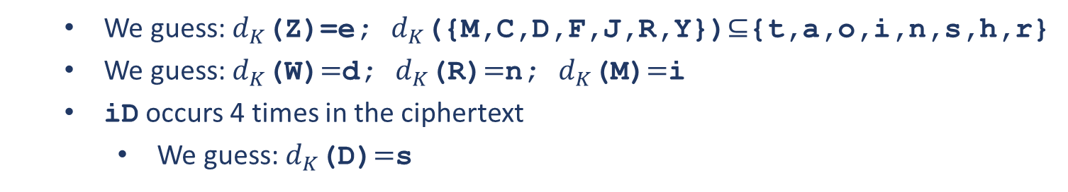
TH, HE, IN, ER, AN, RE, ED, ON, ES, ST, EN, AT, TO, NT, HA, ND, OU, EA, NG, AS, OR, TI, IS, ET, IT, AR, TE, SE, HI, OF.
EXAMPLE: Decrypt the following ciphertext in the substitution cipher:
YIFQFiendQFYVECFiDePCVinedNiDeVEJBTXCDDUiJ
NDIFEFiDeCDiQeKCEYFCJiYnNCdJCSenEXCHeUNiXe
NeUCDnJXYYSinTiEYIFedDYVeVYFeUineCndNeDeJJ
XedGCHSinNiDHNCiFQCHeJiXJedIEJYUCFdDJNeDIn
diagram | iD | in | Fi | iX | Ni | Ji | Si | Ui
No. | 4 | 4 | 3 | 2 | 3 | 2 | 2 | 2
We guess: $d_{K}$(Z)=e; $d_{K}$({M,C,D,F,J,R,Y})$⊆${t,a,o,i,n,s,h,r}
We guess: $d_{K}$(W)$=$d; $d_{K}$(R)$=$n; $d_{K}$(M)$=$i
iD occurs 4 times in the ciphertext
We guess: $d_{K}$(D)$=$s

Slide 7
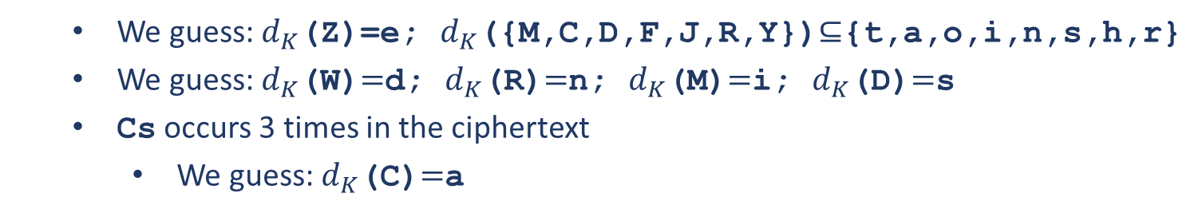
TH, HE, IN, ER, AN, RE, ED, ON, ES, ST, EN, AT, TO, NT, HA, ND, OU, EA, NG, AS, OR, TI, IS, ET, IT, AR, TE, SE, HI, OF.
EXAMPLE: Decrypt the following ciphertext in the substitution cipher:
YIFQFiendQFYVECFisePCVinedNiseVEJBTXCssUiJ
NsIFEFiseCsiQeKCEYFCJiYnNCdJCSenEXCHeUNiXe
NeUCsnJXYYSinTiEYIFedsYVeVYFeUineCndNeseJJ
XedGCHSinNisHNCiFQCHeJiXJedIEJYUCFdsJNesIn
diagram | is | se | Cs | ds | es | sI
No. | 4 | 4 | 3 | 2 | 2 | 2
We guess: $d_{K}$(Z)=e; $d_{K}$({M,C,D,F,J,R,Y})$⊆${t,a,o,i,n,s,h,r}
We guess: $d_{K}$(W)$=$d; $d_{K}$(R)$=$n; $d_{K}$(M)$=$i; $d_{K}$(D)$=$s
Cs occurs 3 times in the ciphertext
We guess: $d_{K}$(C)$=$a

Slide 8
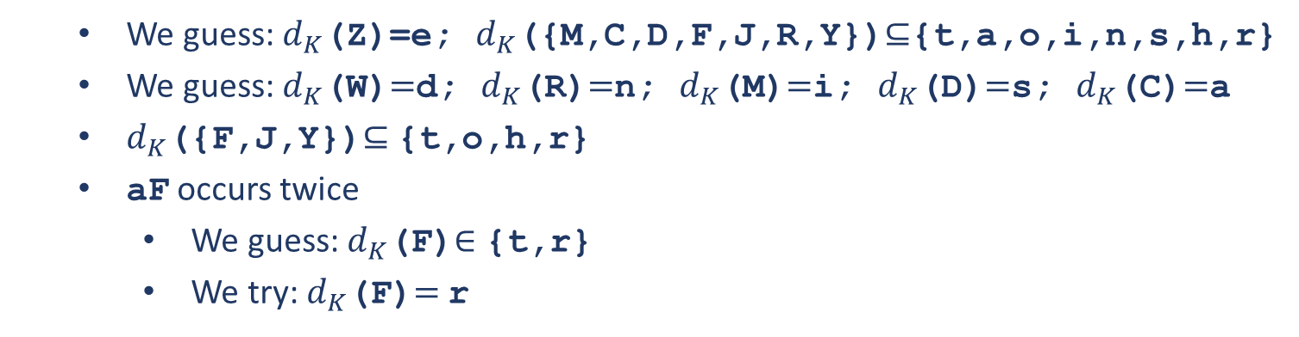
TH, HE, IN, ER, AN, RE, ED, ON, ES, ST, EN, AT, TO, NT, HA, ND, OU, EA, NG, AS, OR, TI, IS, ET, IT, AR, TE, SE, HI, OF.
EXAMPLE: Decrypt the following ciphertext in the substitution cipher:
YIFQFiendQFYVEaFisePaVinedNiseVEJBTXassUiJ
NsIFEFiseasiQeKaEYFaJiYnNadJaSenEXaHeUNiXe
NeUasnJXYYSinTiEYIFedsYVeVYFeUineandNeseJJ
XedGaHSinNisHNaiFQaHeJiXJedIEJYUaFdsJNesIn
diagram | as | aH | aF | ea | Xa | Ua | Na
No. | 4 | 3 | 2 | 2 | 2 | 2 | 2
We guess: $d_{K}$(Z)=e; $d_{K}$({M,C,D,F,J,R,Y})$⊆${t,a,o,i,n,s,h,r}
We guess: $d_{K}$(W)$=$d; $d_{K}$(R)$=$n; $d_{K}$(M)$=$i; $d_{K}$(D)$=$s; $d_{K}$(C)$=$a
$d_{K}$({F,J,Y})$⊆$ {t,o,h,r}
aF occurs twice
We guess: $d_{K}$(F)$∈$ {t,r}
We try: $d_{K}$(F)$=$ r

Slide 9
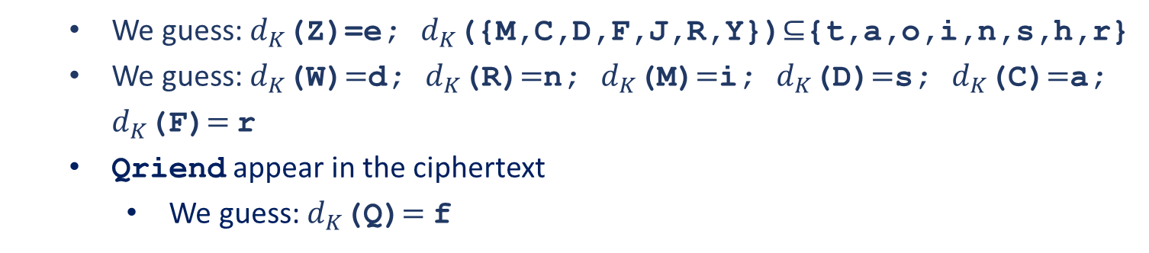
Cryptanalysis of the Substitution Cipher
EXAMPLE: Decrypt the following ciphertext in the substitution cipher:
YIrQriendQrYVEarisePaVinedNiseVEJBTXassUiJ
NsIrEriseasiQeKaEYraJiYnNadJaSenEXaHeUNiXe
NeUasnJXYYSinTiEYIredsYVeVYreUineandNeseJJ
XedGaHSinNisHNairQaHeJiXJedIEJYUardsJNesIn
diagram | as | aH | aF | ea | Xa | Ua | Na
No. | 4 | 3 | 2 | 2 | 2 | 2 | 2
We guess: $d_{K}$(Z)=e; $d_{K}$({M,C,D,F,J,R,Y})$⊆${t,a,o,i,n,s,h,r}
We guess: $d_{K}$(W)$=$d; $d_{K}$(R)$=$n; $d_{K}$(M)$=$i; $d_{K}$(D)$=$s; $d_{K}$(C)$=$a; $d_{K}$(F)$=$ r
Qriend appear in the ciphertext
We guess: $d_{K}$(Q)$=$ f

Slide 10
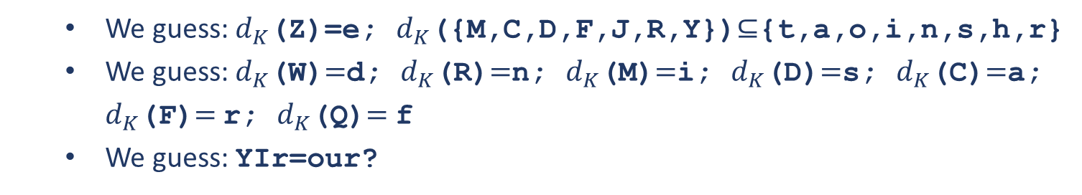
Cryptanalysis of the Substitution Cipher
EXAMPLE: Decrypt the following ciphertext in the substitution cipher:
YIrfriendfrYVEarisePaVinedNiseVEJBTXassUiJ
NsIrEriseasifeKaEYraJiYnNadJaSenEXaHeUNiXe
NeUasnJXYYSinTiEYIredsYVeVYreUineandNeseJJ
XedGaHSinNisHNairfaHeJiXJedIEJYUardsJNesIn
diagram | as | aH | aF | ea | Xa | Ua | Na
No. | 4 | 3 | 2 | 2 | 2 | 2 | 2
We guess: $d_{K}$(Z)=e; $d_{K}$({M,C,D,F,J,R,Y})$⊆${t,a,o,i,n,s,h,r}
We guess: $d_{K}$(W)$=$d; $d_{K}$(R)$=$n; $d_{K}$(M)$=$i; $d_{K}$(D)$=$s; $d_{K}$(C)$=$a; $d_{K}$(F)$=$ r; $d_{K}$(Q)$=$ f
We guess: YIr=our?

Slide 11
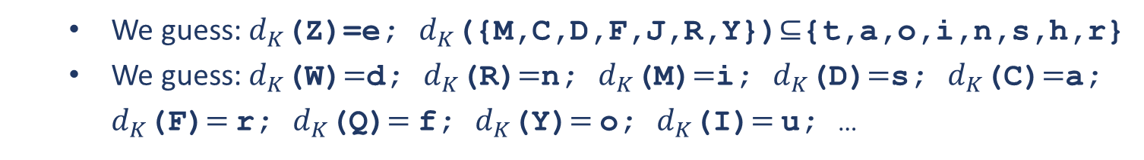
Cryptanalysis of the Substitution Cipher
EXAMPLE: Decrypt the following ciphertext in the substitution cipher:
ourfriendfroVEarisePaVinedNiseVEJBTXassUiJ
NsurEriseasifeKaEoraJiYnNadJaSenEXaHeUNiXe
NeUasnJXooSinTiEouredsoVeVoreUineandNeseJJ
XedGaHSinNisHNairfaHeJiXJeduEJoUardsJNesun
diagram | as | aH | aF | ea | Xa | Ua | Na
No. | 4 | 3 | 2 | 2 | 2 | 2 | 2
We guess: $d_{K}$(Z)=e; $d_{K}$({M,C,D,F,J,R,Y})$⊆${t,a,o,i,n,s,h,r}
We guess: $d_{K}$(W)$=$d; $d_{K}$(R)$=$n; $d_{K}$(M)$=$i; $d_{K}$(D)$=$s; $d_{K}$(C)$=$a; $d_{K}$(F)$=$ r; $d_{K}$(Q)$=$ f; $d_{K}$(Y)$=$ o; $d_{K}$(I)$=$ u; …

Slide 12
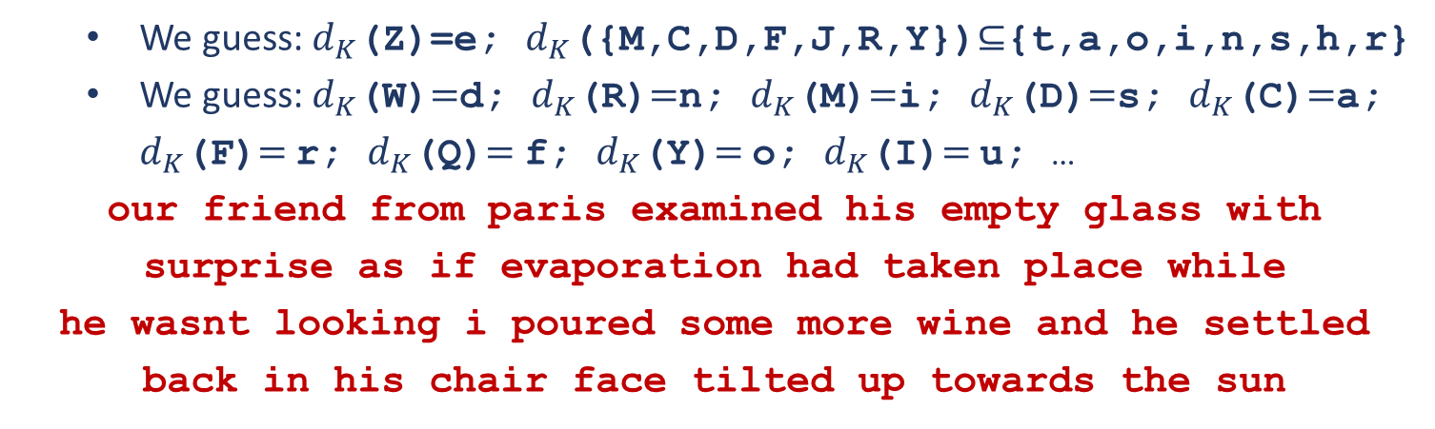
Cryptanalysis of the Substitution Cipher
EXAMPLE: Decrypt the following ciphertext in the substitution cipher:
ourfriendfromparisexaminedhisemptyglasswit
hsurpriseasifevaporationhadtakenplacewhile
hewasntlookingipouredsomemorewineandhesett
ledbackinhischairfacetilteduptowardsthesun
diagram | as | aH | aF | ea | Xa | Ua | Na
No. | 4 | 3 | 2 | 2 | 2 | 2 | 2
We guess: $d_{K}$(Z)=e; $d_{K}$({M,C,D,F,J,R,Y})$⊆${t,a,o,i,n,s,h,r}
We guess: $d_{K}$(W)$=$d; $d_{K}$(R)$=$n; $d_{K}$(M)$=$i; $d_{K}$(D)$=$s; $d_{K}$(C)$=$a; $d_{K}$(F)$=$ r; $d_{K}$(Q)$=$ f; $d_{K}$(Y)$=$ o; $d_{K}$(I)$=$ u; …
our friend from paris examined his empty glass with surprise as if evaporation had taken place while
he wasnt looking i poured some more wine and he settled back in his chair face tilted up towards the sun

Slide 14
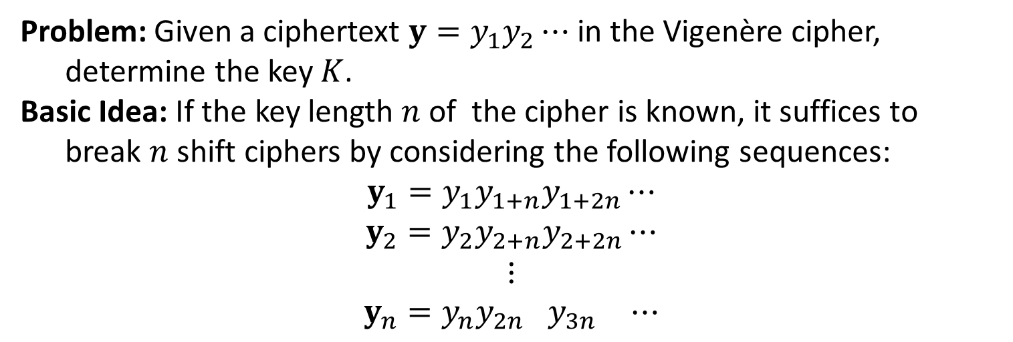
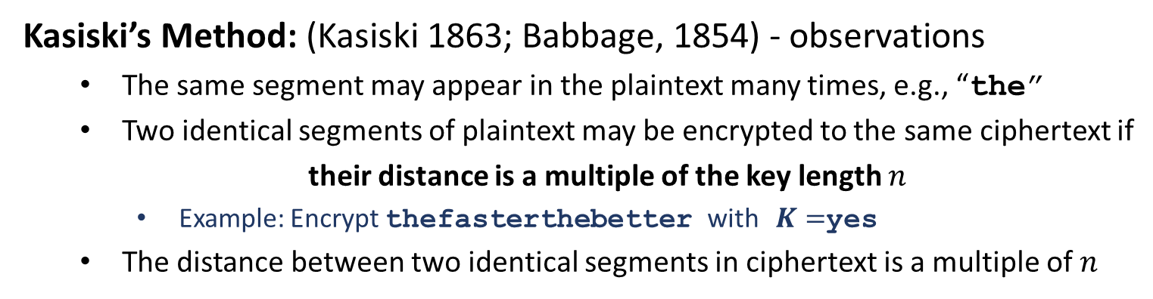
Cryptanalysis of the Vigenère Cipher
Problem: Given a ciphertext ${y=y}_{1}y_{2}⋯$ in the Vigenère cipher,
determine the key $K$.
Basic Idea: If the key length $n$ of the cipher is known, it suffices to
break $n$ shift ciphers by considering the following sequences:
$${y_{1}=y}_{1}y_{1+n}y_{1+2n}⋯$$
$${y_{2}=y}_{2}y_{2+n}y_{2+2n}⋯$$
$$⋮$$
$${y_{n}=y}_{n}y_{2n+ }y_{3n+ }⋯$$
Kasiski’s Method: (Kasiski 1863; Babbage, 1854) - observations
The same segment may appear in the plaintext many times, e.g., “the”
Two identical segments of plaintext may be encrypted to the same ciphertext if
their distance is a multiple of the key length $n$
Example: Encrypt thefasterthebetter with $K=$yes
The distance between two identical segments in ciphertext is a multiple of $n$

Slide 15
Cryptanalysis of the Vigenère Cipher
Kasiski’s Method: (Kasiski 1863; Babbage, 1854) - algorithm
Search the ciphertext for pairs of identical segments of length at least three;
Record the distances between the starting positions of any two segments;
Output the greatest common divisor of these distances.
EXAMPLE: Determine the key length for the following ciphertext.
CHREEVOAHMAERATBIAXXWTNXBEEOPHBSBQMQEQERBW
RVXUOAKXAOSXXWEAHBWGJMMQMNKGRFVGXWTRZXWIAK
LXFPSKAUTEMNDCMGTSXMXBTUIADNGMGPSRELXNJELX
VRVPRTULHDNQWTWDTYGBPHXTFALJHASVBFXNGLLCHR
ZBWELEKMSJIKNBHWRJGNMGJSGLXFEYPHAGNRBIEQJT
AMRVLCRREMNDGLXRRIMGNSNRWCHRQHAEYEVTAQEBBI
PEEWEVKAKOEWADREMXMTBHHCHRTKDNVRZCHRCLQOHP
WQAIIWXNRMGWOIIFKEE
CHR appear 5 times.
Locations: 1,166, 236, 276, 286.
Distances 165, 235, 275, 285
GCD is 5
Guess: key length is 5

Slide 16
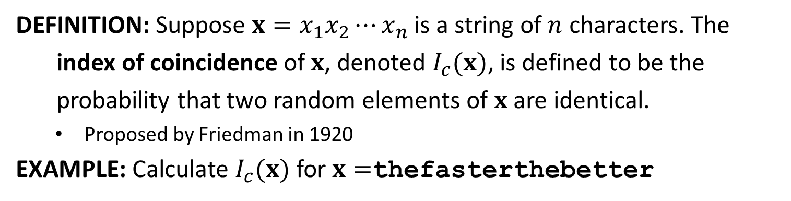

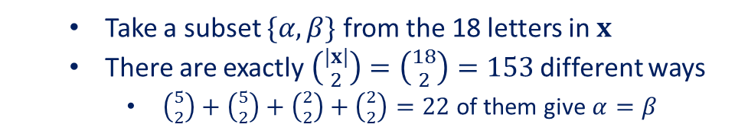
Cryptanalysis of the Vigenère Cipher
DEFINITION: Suppose $x=x_{1}x_{2}⋯x_{n}$is a string of $n$ characters. The
index of coincidence of $x$, denoted $I_{c}(x)$, is defined to be the
probability that two random elements of $x$ are identical.
Proposed by Friedman in 1920
EXAMPLE: Calculate $I_{c}(x)$ for $x=$thefasterthebetter
letter | e | t | h | r | a | b | f | S
No. | 5 | 5 | 2 | 2 | 1 | 1 | 1 | 1
Take a subset $\{α,β\}$ from the 18 letters in $x$
There are exactly $\left({|x| \atop 2}\right)=\left({18 \atop 2}\right)=153$ different ways
$\left({5 \atop 2}\right)+\left({5 \atop 2}\right)+\left({2 \atop 2}\right)+\left({2 \atop 2}\right)=22$ of them give $α=β$
$I_{c}\left(x\right)=\frac{22}{153}$

Slide 17
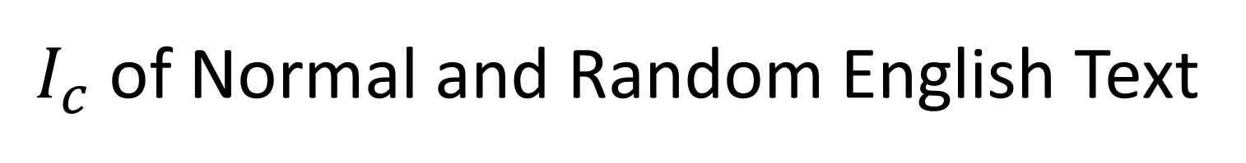
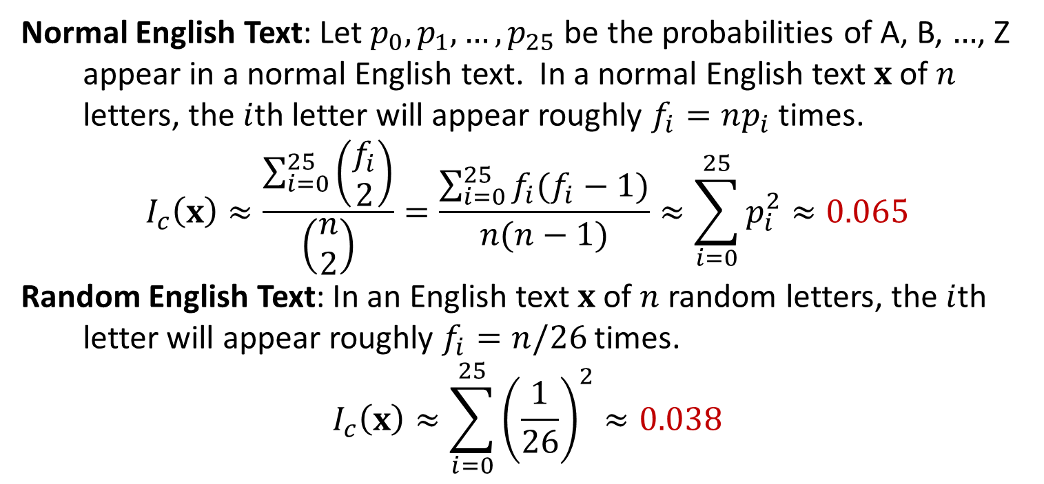
$I_{c}$ of Normal and Random English Text
Normal English Text: Let $p_{0},p_{1},…,p_{25}$ be the probabilities of A, B, $…$, Z
appear in a normal English text. In a normal English text $x$ of $n$
letters, the $i$th letter will appear roughly $f_{i}=np_{i}$ times.
$$I_{c}\left(x\right)≈\frac{\sum_{i=0}^{25}{\left(\begin{matrix}f_{i} \\ 2\end{matrix}\right)}}{\left(\begin{matrix}n \\ 2\end{matrix}\right)}=\frac{\sum_{i=0}^{25}{f_{i}(f_{i}−1)}}{n(n−1)}≈\sum_{i=0}^{25}{p_{i}^{2}}≈0.065$$
Random English Text: In an English text $x$ of $n$ random letters, the $i$th
letter will appear roughly $f_{i}=n/26$ times.
$$I_{c}\left(x\right)≈\sum_{i=0}^{25}{{\left(\frac{1}{26}\right)}^{2}≈0.038}$$

Slide 18

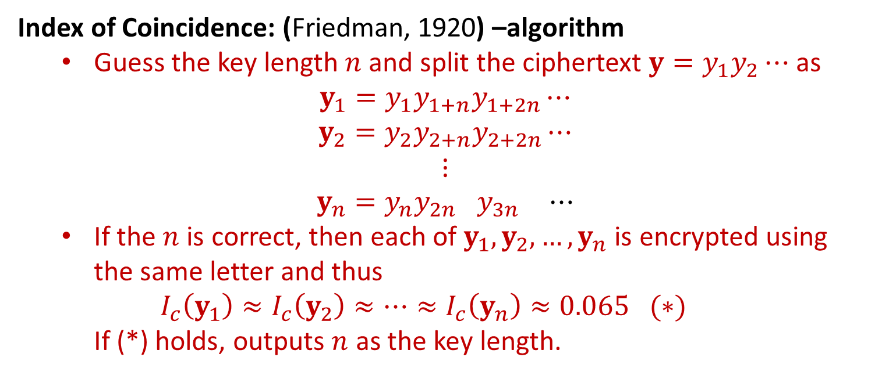
Determine Key Length with $I_{c}$
Index of Coincidence: (Friedman, 1920) –algorithm
Guess the key length $n$ and split the ciphertext $y=y_{1}y_{2}⋯$ as
$${y_{1}=y}_{1}y_{1+n}y_{1+2n}⋯$$
$${y_{2}=y}_{2}y_{2+n}y_{2+2n}⋯$$
$$⋮$$
$${y_{n}=y}_{n}y_{2n+ }y_{3n+ }⋯$$
If the $n$ is correct, then each of $y_{1},y_{2},…,y_{n}$ is encrypted using the same letter and thus
$$I_{c}\left(y_{1}\right)≈I_{c}\left(y_{2}\right)≈⋯≈I_{c}\left(y_{n}\right)≈0.065 (∗)$$
If (*) holds, outputs $n$ as the key length.

Slide 19
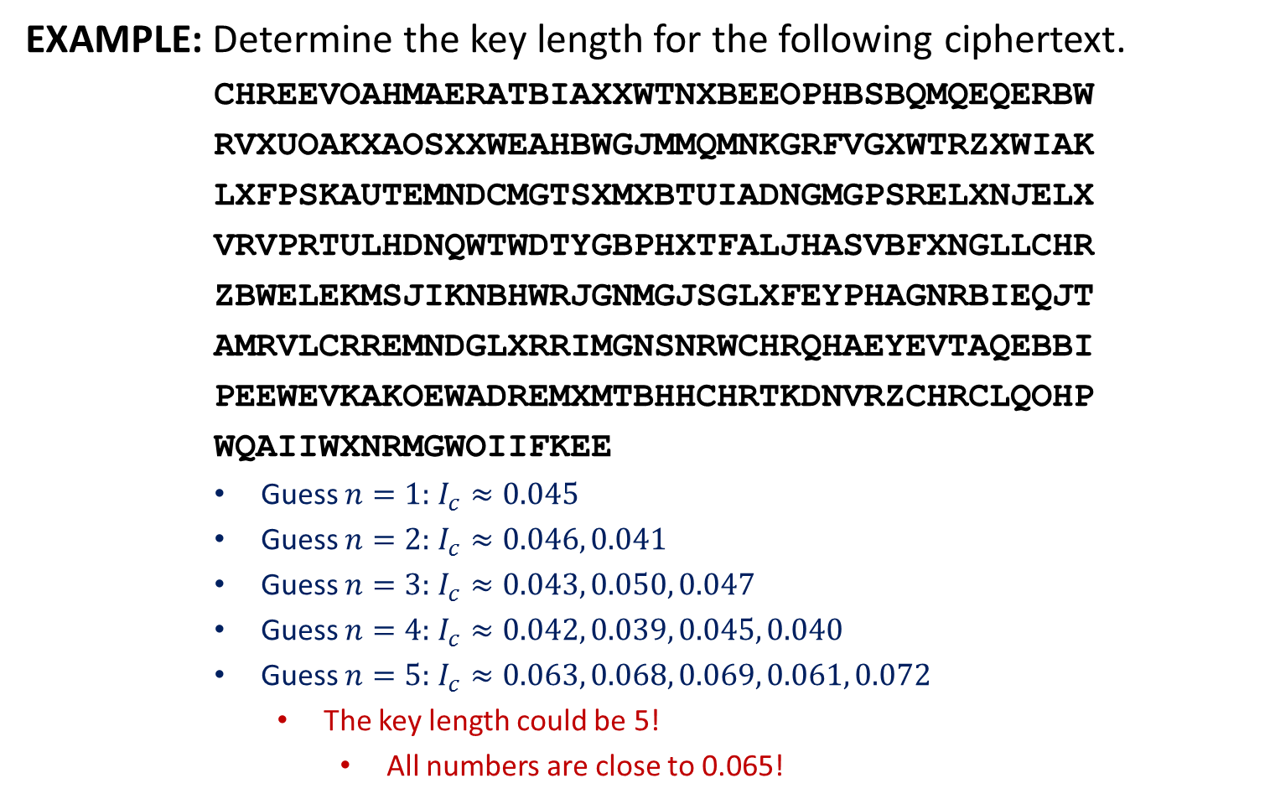
Determine Key Length with $I_{c}$
EXAMPLE: Determine the key length for the following ciphertext.
CHREEVOAHMAERATBIAXXWTNXBEEOPHBSBQMQEQERBW
RVXUOAKXAOSXXWEAHBWGJMMQMNKGRFVGXWTRZXWIAK
LXFPSKAUTEMNDCMGTSXMXBTUIADNGMGPSRELXNJELX
VRVPRTULHDNQWTWDTYGBPHXTFALJHASVBFXNGLLCHR
ZBWELEKMSJIKNBHWRJGNMGJSGLXFEYPHAGNRBIEQJT
AMRVLCRREMNDGLXRRIMGNSNRWCHRQHAEYEVTAQEBBI
PEEWEVKAKOEWADREMXMTBHHCHRTKDNVRZCHRCLQOHP
WQAIIWXNRMGWOIIFKEE
Guess $n=1:$ $I_{c}≈0.045$
Guess $n=2:$ $I_{c}≈0.046, 0.041$
Guess $n=3:$ $I_{c}≈0.043, 0.050, 0.047$
Guess $n=4:$ $I_{c}≈0.042, 0.039, 0.045, 0.040$
Guess $n=5:$ $I_{c}≈0.063, 0.068, 0.069, 0.061, 0.072$
The key length could be 5!
All numbers are close to 0.065!

Slide 20

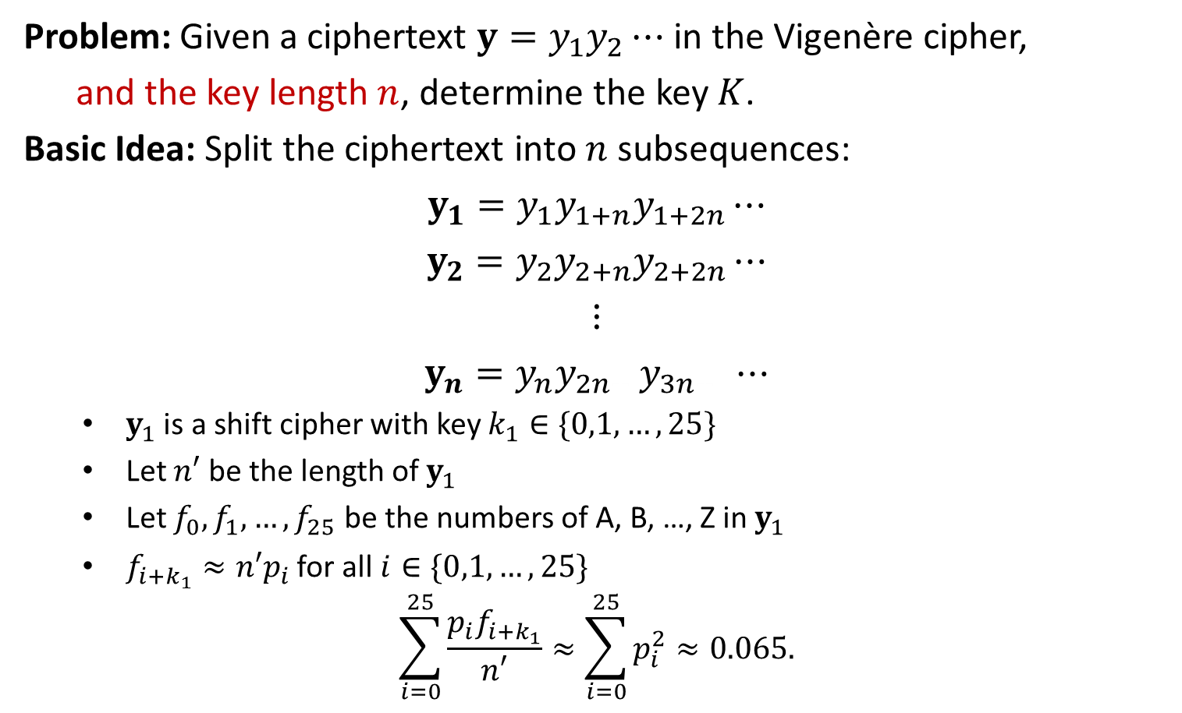
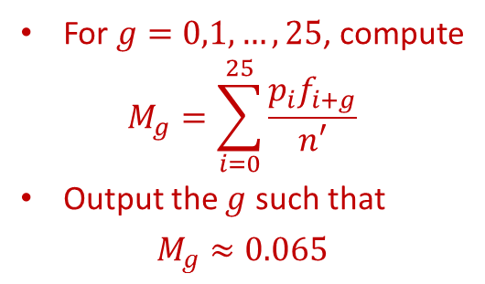
How to Determine $K$?
Problem: Given a ciphertext ${y=y}_{1}y_{2}⋯$ in the Vigenère cipher,
and the key length $n$, determine the key $K$.
Basic Idea: Split the ciphertext into $n$ subsequences:
$${y_{1}=y}_{1}y_{1+n}y_{1+2n}⋯$$
$${y_{2}=y}_{2}y_{2+n}y_{2+2n}⋯$$
$$⋮$$
$${y_{n}=y}_{n}y_{2n+ }y_{3n+ }⋯$$
$y_{1}$ is a shift cipher with key $k_{1}∈\{0,1,…,25\}$
Let $n′$ be the length of $y_{1}$
Let $f_{0},f_{1},…,f_{25}$ be the numbers of A, B, …, Z in $y_{1}$
$f_{i+k_{1}}≈n′p_{i}$ for all $i∈\{0,1,…,25\}$
$$\sum_{i=0}^{25}{\frac{p_{i}f_{i+k_{1}}}{n′}}≈\sum_{i=0}^{25}{p_{i}^{2}}≈0.065.$$
For $g=0,1,…,25$, compute
$$M_{g}=\sum_{i=0}^{25}{\frac{p_{i}f_{i+g}}{n′}}$$
Output the $g$ such that
$$M_{g}≈0.065$$

Slide 21
Determine the Key
EXAMPLE: Determine the plaintext for the following ciphertext.
CHREEVOAHMAERATBIAXXWTNXBEEOPHBSBQMQEQERBW
RVXUOAKXAOSXXWEAHBWGJMMQMNKGRFVGXWTRZXWIAK
LXFPSKAUTEMNDCMGTSXMXBTUIADNGMGPSRELXNJELX
VRVPRTULHDNQWTWDTYGBPHXTFALJHASVBFXNGLLCHR
ZBWELEKMSJIKNBHWRJGNMGJSGLXFEYPHAGNRBIEQJT
AMRVLCRREMNDGLXRRIMGNSNRWCHRQHAEYEVTAQEBBI
PEEWEVKAKOEWADREMXMTBHHCHRTKDNVRZCHRCLQOHP
WQAIIWXNRMGWOIIFKEE
We guess the key length is 5. Split the ciphertext into 5 sequences:
EMTXBHMRXXXBMGXXLKMGXAGLLPHTGTHFLBKKRGXHBTLMXGWHVBEAAXHKZLWWGF
CVABWEBQBUAWWQRWWXANTBDPXXRDWBFAXCWMNJJFAIACNRNCATBWKDMCDCQQXWK
HOEITESEWOOEGMFTIFUDSTNSNVTNDPASNHESBGSEGEMRDRSHEAIEORTHNHOANOE
RARANOBQRASAJNVRAPTCXUGRJRUQTHLVGRLJHNGYNQRRGINRYQPVEEBRVRHIRIE
EHAXXPQEVKXHMKGZKSEMMIMEEVLWYXJBLZEIWMLPRJVELMRQEEEKWMHTRCPIMI

Slide 22

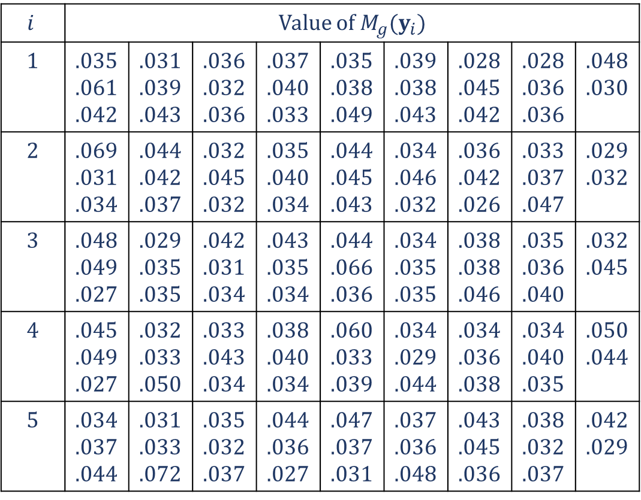
Determine the Key
$$i$$ | Value of $M_{g}(y_{i})$
1 | .035 .061 .042 | .031 .039 .043 | .036 .032 .036 | .037 .040 .033 | .035 .038 .049 | .039 .038 .043 | .028 .045 .042 | .028 .036 .036 | .048 .030
2 | .069 .031 .034 | .044 .042 .037 | .032 .045 .032 | .035 .040 .034 | .044 .045 .043 | .034 .046 .032 | .036 .042 .026 | .033 .037 .047 | .029 .032
3 | .048 .049 .027 | .029 .035 .035 | .042 .031 .034 | .043 .035 .034 | .044 .066 .036 | .034 .035 .035 | .038 .038 .046 | .035 .036 .040 | .032 .045
4 | .045 .049 .027 | .032 .033 .050 | .033 .043 .034 | .038 .040 .034 | .060 .033 .039 | .034 .029 .044 | .034 .036 .038 | .034 .040 .035 | .050 .044
5 | .034 .037 .044 | .031 .033 .072 | .035 .032 .037 | .044 .036 .027 | .047 .037 .031 | .037 .036 .048 | .043 .045 .036 | .038 .032 .037 | .042 .029
$K=\left(9,0,13,4,19\right)=$JANET

